Slide 1

BUSINESS ANALYTICS CAR SALES ANALYSIS WITH SAS EFTHYMIOS MAVRIDIS/efth.mavridis@mc-class.gr​ UNIVERSITY OF DERBY –MEDITERRANEAN COLLEGE​

Slide 2

DATASET
The dataset contains information related to car sales, recording details about the transaction date, customer, characteristics of the sold car, and the sales representative. It includes data such as the unique identifier of the car, the name and gender of the customer, the customer's annual income, the make and model of the car, as well as technical characteristics like the engine type and transmission type. It also provides details about the color, price, body style of the car, the phone number associated with the sale, and the region of the representative. These pieces of information can be used for analyzing trends in car sales, distribution of customer preferences, and performance of the representatives.

Slide 3
DATASET
Car_id: A unique identifier for each car.
Date: The date of the car sale.
Customer_Name: The name of the customer who purchased the car.
Gender: The gender of the customer.
Annual_Income: The customer's annual income.
Dealer_Name: The name of the dealer who sold the car.
Company: The car manufacturing company.
Model: The model of the car.

Slide 4
DATASET
Engine: The type of engine of the car.
Transmission: The type of transmission (Automatic or Manual).
Color: The color of the car.
Price: The selling price of the car.
Dealer_No: A unique code for the dealer.
Body Style: The body style of the car.
Phone: A phone number related to the sale or the dealer.
Dealer_Region: The region where the dealer is located.

Slide 5

DATASET ANALYSIS
For this dataset we can provide the following analysis:
Customer Demographics
Car Sales Analysis
Dealer Performance
Regional Analysis
Trends Over Time
Correlation Analysis

Slide 6
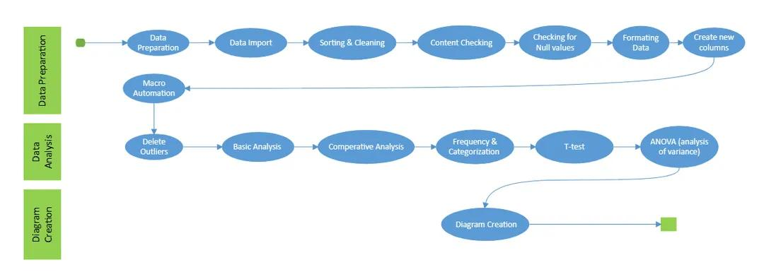
UML DIAGRAM

Slide 7
PROC DESCRIPTION
PROC IMPORT is a convenient and efficient way to bring external data into SAS for analysis and manipulation.
PROC SORT is a fundamental procedure in SAS for arranging data in a specified order, which is often necessary for subsequent analysis or reporting tasks.
PROC CONTENTS is a valuable tool for exploring the contents of SAS datasets, providing essential information that can help you better understand and work with your data
PROC PRINT is a convenient and efficient way to view the contents of a SAS dataset, providing essential information for data exploration and analysis.

Slide 8
PROC DESCRIPTION
PROC MEANS is a powerful procedure for generating descriptive statistics in SAS, providing valuable insights into the characteristics of numeric variables within a dataset.
PROC FASTCLUS is a useful procedure for performing clustering analysis efficiently on large datasets in SAS, providing insights into patterns and structures within the data.
PROC SQL provides a flexible and powerful way to interact with data in SAS, allowing you to leverage SQL's capabilities for data manipulation and analysis.
PROC FREQ is a versatile procedure for analyzing categorical data in SAS, providing valuable insights into the distribution and relationships of categorical variables within a dataset.

Slide 9
PROC DESCRIPTION
PROC TABULATE is a powerful procedure for creating customized tables and summary reports in SAS, providing flexibility and control over the appearance and content of the output.
PROC TTEST is a powerful procedure for performing t-tests in SAS, providing statistical tests and confidence intervals to assess differences between group means.
PROC ANOVA is a versatile procedure for conducting ANOVA tests in SAS, providing statistical tests and summaries to assess differences in means across multiple groups.
PROC SGPLOT is a versatile procedure for creating high-quality visualizations in SAS, providing a wide range of options for customizing plots to suit your needs.

Slide 10

AUTOMATION
Automating tasks in SAS can greatly improve efficiency and reduce the likelihood of errors. SAS provides several methods for automating tasks, including the use of macros, batch processing, scheduling, and integration with other programming languages or tools. Here's how you can automate tasks in SAS.
Macros: SAS macros allow you to define reusable pieces of code that can be called with different parameters. Macros are especially useful for automating repetitive tasks or for parameterizing parts of your SAS programs. You can define macros using the %macro and %mend statements, and then call them using the %macro_name syntax.

Slide 11
AUTOMATION
For the objective of automating some tasks in our code we used this command: %macro generate_plot(plot_type);
Macros in SAS are essentially programming constructs that allow you to automate repetitive tasks or to parameterize parts of your SAS code for reuse. By creating a macro, you can encapsulate a set of SAS statements into a reusable block of code. The macro accepts a parameter like plot_type, which allows you to specify the type of plot you want to generate when you call the macro. By using a macro, you ensure consistency in the way plots are generated throughout your SAS code. Macros can help improve code efficiency by reducing redundancy and promoting code reuse. Once the macro is defined, you can call it whenever you need to generate a plot, saving you time and effort in writing and maintaining code.

Slide 12

THANK YOU !

